Slide 1
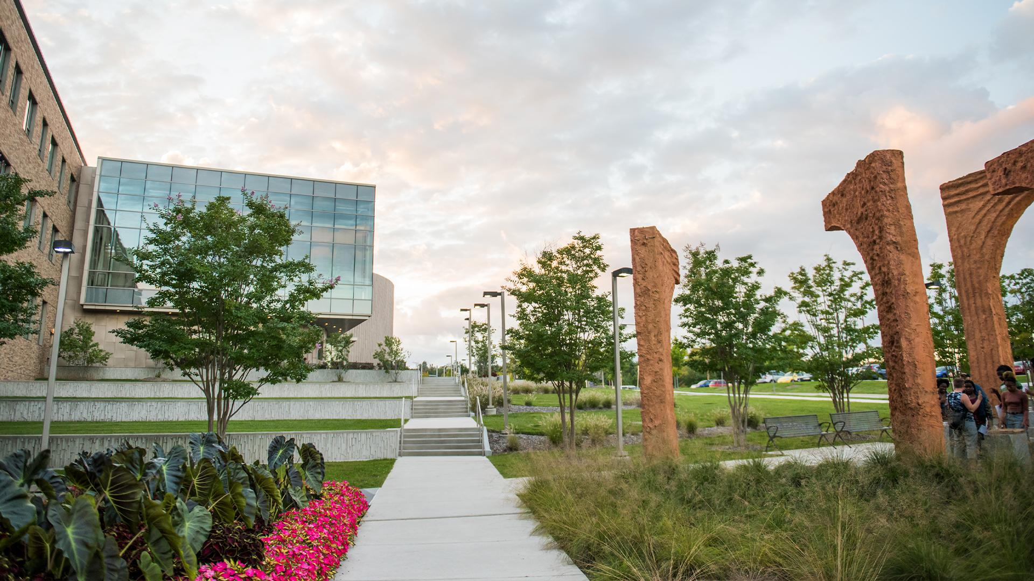
RIH
Counselling Center

Slide 2
Team 06 : Tech Marvel
Esha, Singh
Taruna, Pakhare
Mouna, Chimata
Bhargavi, Gudapati
Akhil, Rudrabatla

Slide 3

Previous Work
Reducing patient wait times
Improving the integration of electronic health records
Streamlining communication between departments

Slide 4




Data Flow Diagram
Student
Counselor
Student
Counselor
Provides information
Calls to request appointment
Asks about needs, preferences, availability
Check for availability and provide details
Getting access to data
Storing Details
Appointment Confirmation
Storing appointment details

Slide 5
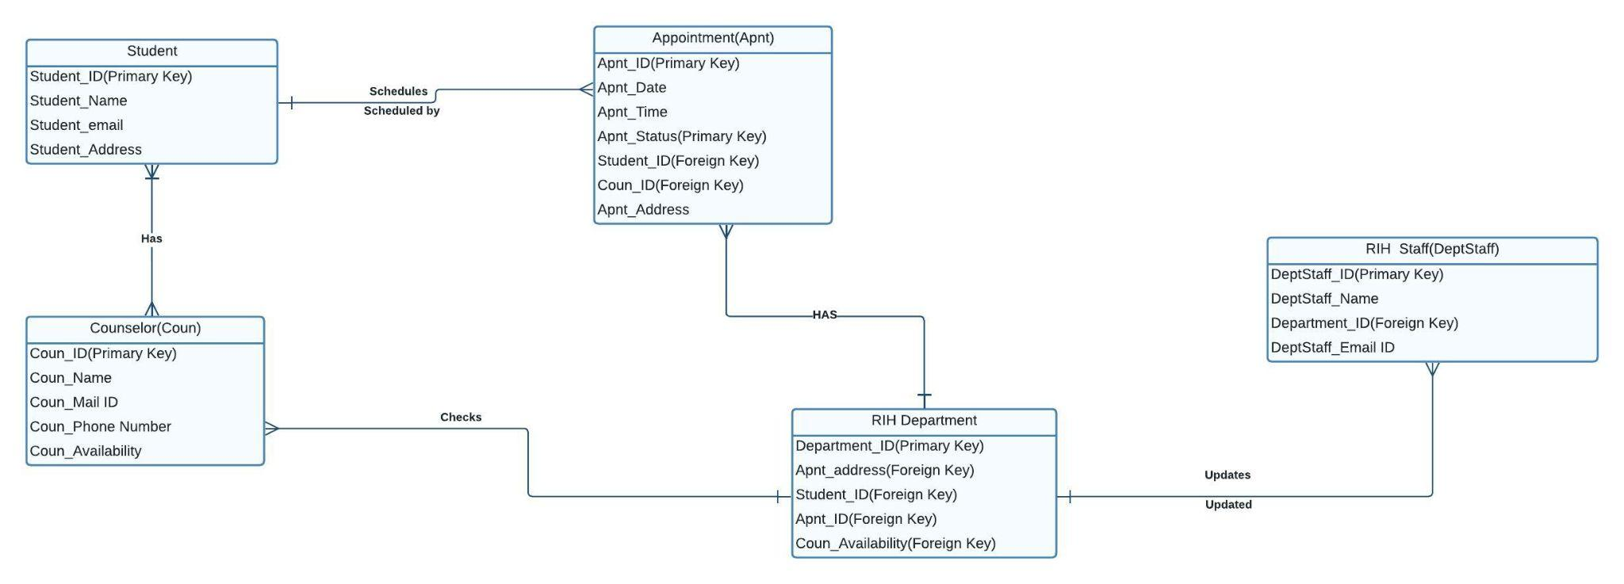
Entity Relationship Diagram

Slide 6


